Slide 1
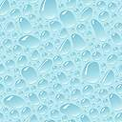
Unit 1: Water Technology Topic: Water, Its Impurities and Quality Parameters
Dr. P. G. Umape
Assistant Professor
Pune Institute of Computer Technology

Slide 2
Learning outcomes
Student should be able to
Recognise different types of impurities present in water
Suggest the method to eliminate the impurity from water
Know different water quality parameters

Slide 3
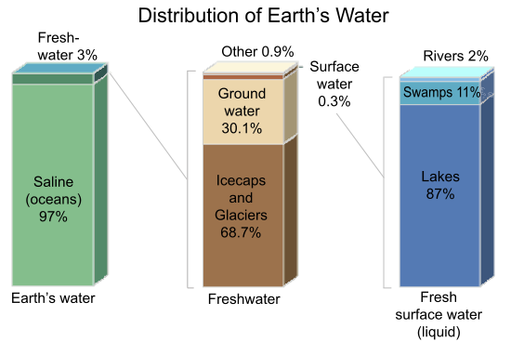
Distribution of water on earth
Water is the most important commodity on the earth for the existence of ecosystem.
It is mainly used for domestic and industrial purpose by human.
The water available for use is not pure and hence it can not be used directly for domestic or industrial purpose.
Source: https://www.e-education.psu.edu/earth103/node/701

Slide 4
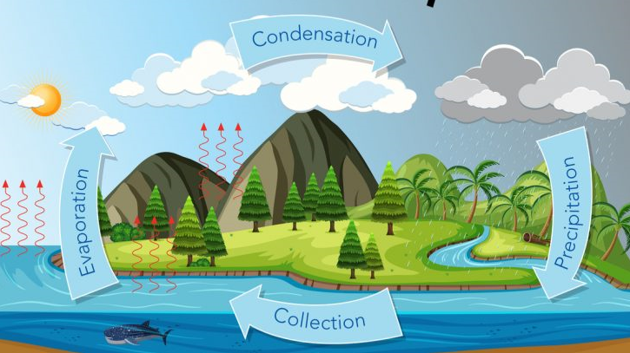
Water cycle
How water gets contaminated ?
Source: https://www.earth.com/earthpedia-articles/water-cycle/

Slide 5
Impurities in Water
Suspended Impurities
Visible to naked eye, >1000 Å
e.g. soil, sand, animal and vegetable matter.
Can be removed by filtration, sedimentation.
Colloidal impurities
Invisible to naked eye, 10 to 1000 Å.
e.g. finely divided silica, animal and veg. matter, dispersed oil and greasy matter.
Can be removed by coagulation, sedimentation and filtration.

Slide 6
Impurities in Water
Dissolved impurities
Organic: e.g. organic acids and bases, dyes , detergent, organic salts, fertilizers, pesticides etc
Inorganic: Mainly Calcium and Magnesium salts (with small quantities of Fe, Mn, Al, Zn Na, K salts )
Dissolved gases: CO₂, O₂, H₂S, NH₃ etc.
Dissolved impurites can be removed by techniques like Ion exchange, RO,UF, Zeolite etc

Slide 7
Impurities in Water
Biological impurities:
Bacteria, Fungi, Algae and other microorganisms
Sterilization will be required for purification
Sterilization can be carried out by addition of chlorine (Hypochlorite, Bleaching powder, Cl₂ gas, ), Ozonolysis etc.

Slide 8
Water quality parameters
Based on the type of impurity present and its extent, different quality parameters have been attributed to the water.
Following are the different water quality parameters
Color, Odor, Turbidity, pH, Acidity, Alkalinity, Chloride content, Hardness, Total dissolved solid, COD, BOD, Dissolved oxygen content etc
Hardness

Slide 9
Summary
Water cycle
Different types of impurities present in water
Different water quality parameters

